Slide 1

Neural Networks Assignment
INFO 6105
Parth Kalani
002766306

Slide 2

Problem Statement
Continue with the small example discussed yesterday in the class. The notebook file has been uploaded in the Files section. Generate 100 more random samples around each of the existing two classes and then run one of the two NNs with two hidden layers and evaluate the performance.
Implement a simple feed-forward neural network model for the loan dataset and then evaluate the performance on a 80/20 split. Exclude irrelevant columns and perform one-hot encoding and normalization of each column, if needed.

Slide 3
Technical Approach
Create/ Load
Create Dataset/ Load the loan dataset
Process
Test and Train split
Implement 1
Implement two NNs with two hidden layers
Implement 2
Implement a simple feed-forward neural network model for the loan dataset
Compare
Compare the results for both implementation (1st Tow models and 2nd Train/Test runs)

Slide 4
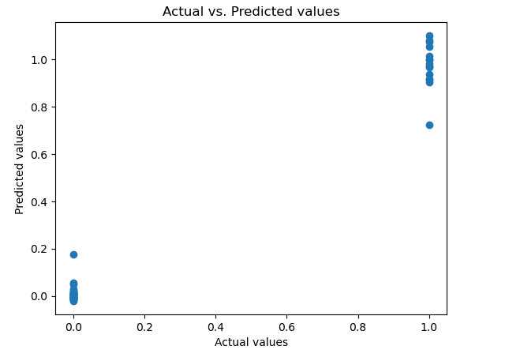
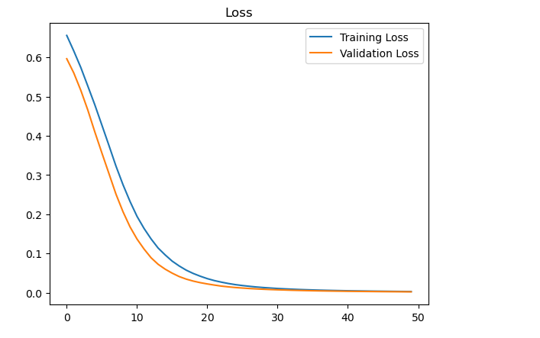
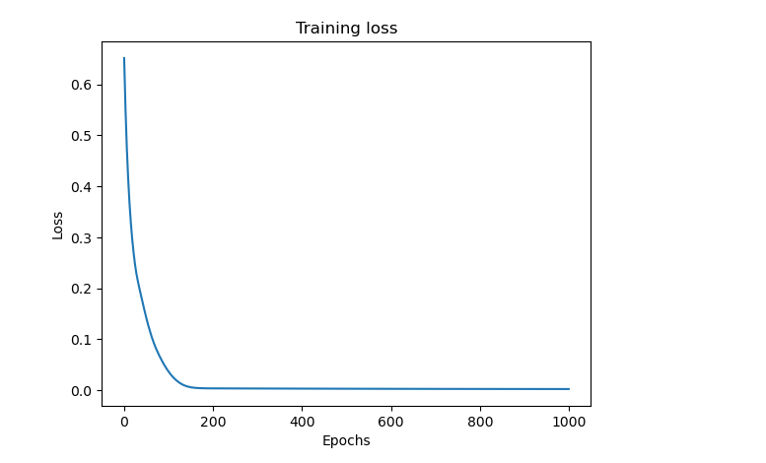
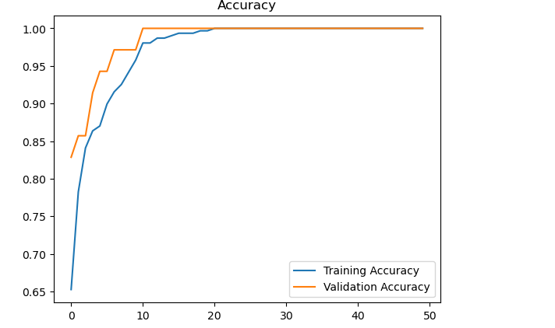
Results

Slide 5
Conclusion
By this assignment, we learnt about Neural networks modelling
1
We compared the results for two different implementations
2
We compared the nn modelling on loan dataset for test and train data
3

